Slide 1


Kacper Gawroński
26/08/2025

Slide 2

Outline
Executive Summary
Introduction
Methodology
Results
Conclusion
Appendix

Slide 3
Executive Summary
Summary of methodologies
Summary of all results

Slide 4
Introduction
Project background and context
Problems you want to find answers

Slide 5

Section 1

Slide 6
Methodology
Executive Summary
Data collection methodology:
Describe how data was collected
Through requests library in python
Perform data wrangling
Describe how data was processed
Additional column was created – class, some filtering was used as well
Perform exploratory data analysis (EDA) using visualization and SQL
Perform interactive visual analytics using Folium and Plotly Dash
Perform predictive analysis using classification models
How to build, tune, evaluate classification models
Use scikit learn for model creation, transform them with for example standard scaler if needed, for tuning use GridSearchCV for evalutaion use ideally more than one metric for classification, accuracy, f1, precision and recall (and many more)

Slide 7
Data Collection
Describe how data sets were collected.
You need to present your data collection process use key phrases and flowcharts
Import request library for python, use spacex api, get the json and use json_normalize function in pandas to tranfsorm it into dataframe
Alternatively use beautiful soup and request library and go through webscraping the wikipedia page

Slide 8
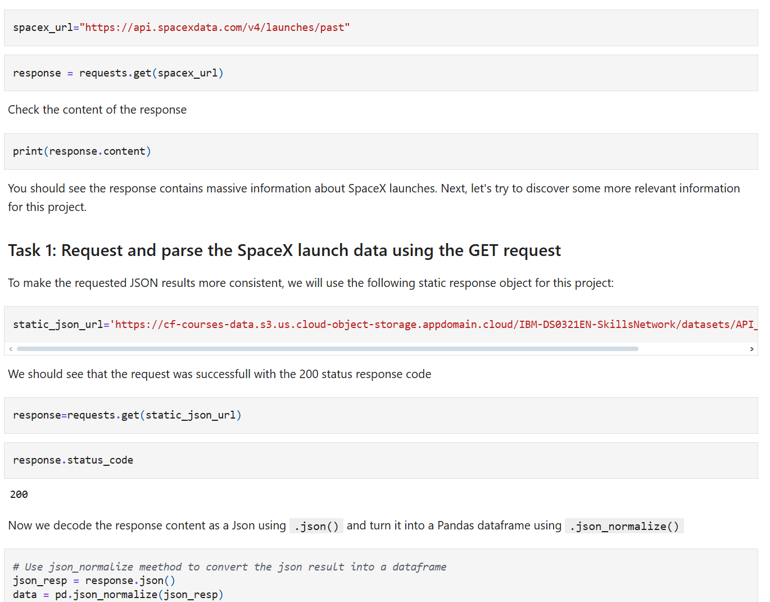
Data Collection – SpaceX API
Present your data collection with SpaceX REST calls using key phrases and flowcharts
Add the GitHub URL of the completed SpaceX API calls notebook (must include completed code cell and outcome cell), as an external reference and peer-review purpose
Place your flowchart of SpaceX API calls here

Slide 9
Data Collection - Scraping
Present your web scraping process using key phrases and flowcharts
Add the GitHub URL of the completed web scraping notebook, as an external reference and peer-review purpose
Use get from request library
Create dataframe out of created lists
Scrape the whole table from wikipedia
Go through every row in the table and scrape all required info from this, add each column to the appropriate list

Slide 10
Data Wrangling
Describe how data were processed
You need to present your data wrangling process using key phrases and flowcharts
Add the GitHub URL of your completed data wrangling related notebooks, as an external reference and peer-review purpose
Get all mission outcomes and aggregate them into success and failure groups
Create new column class, where 1 means mission success and 0 a failure

Slide 11
EDA with Data Visualization
Summarize what charts were plotted and why you used those charts
Add the GitHub URL of your completed EDA with data visualization notebook, as an external reference and peer-review purpose
I used scatter plots for inspecting possible covariances between independent variables

Slide 12
EDA with SQL
Using bullet point format, summarize the SQL queries you performed
Basic Selects that use WHERE clause
Selects that use aggregate functions
Selects that use subqueries
Add the GitHub URL of your completed EDA with SQL notebook, as an external reference and peer-review purpose

Slide 13
Build an Interactive Map with Folium
Summarize what map objects such as markers, circles, lines, etc. you created and added to a folium map
I used markers and MarkerCluster to group them, also I used Circle objects that utilized Popup object
Explain why you added those objects
I used these object to higlight important information form spacex dataset
Add the GitHub URL of your completed interactive map with Folium map, as an external reference and peer-review purpose

Slide 14
Build a Dashboard with Plotly Dash
Summarize what plots/graphs and interactions you have added to a dashboard
Explain why you added those plots and interactions
Add the GitHub URL of your completed Plotly Dash lab, as an external reference and peer-review purpose
I added pie chart and scatter plot, for that I created slider for choosing the payload weight bracket in scatter plot and selector field for choosing the launch site, this dashboard was using callbacks for interactivity

Slide 15
Predictive Analysis (Classification)
Summarize how you built, evaluated, improved, and found the best performing classification model
You need present your model development process using key phrases and flowchart
Add the GitHub URL of your completed predictive analysis lab, as an external reference and peer-review purpose
Create classification models with sklearn
Create GridSearch for every model and fit it to find best parameters
Analzye the models with bar plots of few metrics like accuracy and f1_score to find the best model
Divide the dataset into train and test set

Slide 16
Results
Exploratory data analysis results
Interactive analytics demo in screenshots
Predictive analysis results
Success rate of mission depends on orbit type, some launchsite did not launch rockets with high payload mass, for LEO orbits it seems that success depended on the number of tries, success rate kept increasing with each year

Slide 17

Section 2

Slide 18
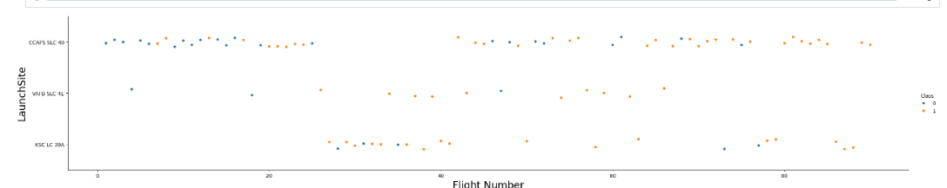
Flight Number vs. Launch Site
Show a scatter plot of Flight Number vs. Launch Site
Show the screenshot of the scatter plot with explanations
There seems that after some number of flights in each site the success rate is 100%

Slide 19
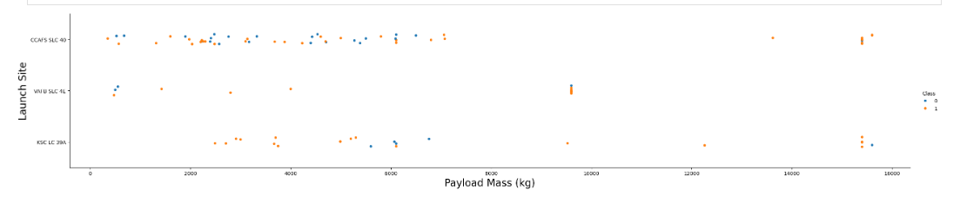
Payload vs. Launch Site
Show a scatter plot of Payload vs. Launch Site
Show the screenshot of the scatter plot with explanations
There are no launches with payload mass greater than 10000 Kg for VAFB-SLC, additionally after exceeding 10000 Kg Payload Mass the success rate for CCAFS-SLC is 100%

Slide 20
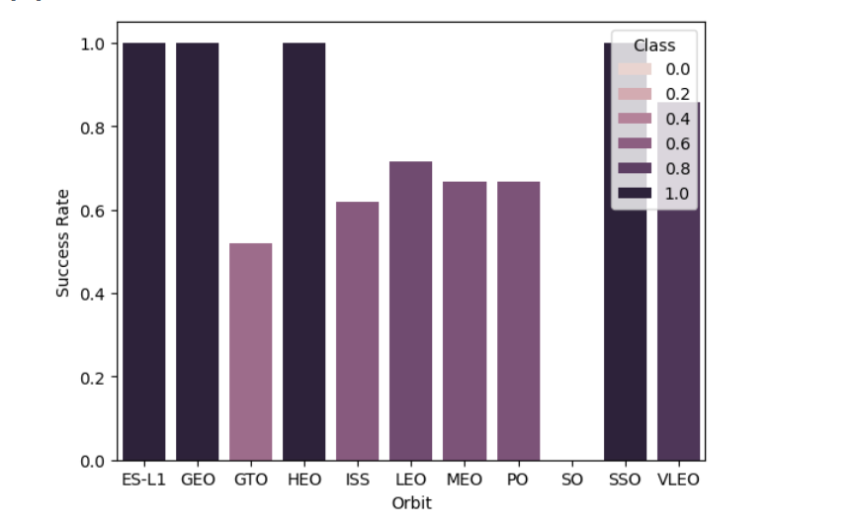
Success Rate vs. Orbit Type
Show a bar chart for the success rate of each orbit type
Show the screenshot of the scatter plot with explanations
Success rate depends on Orbit type, for some the success rate is 100%

Slide 21
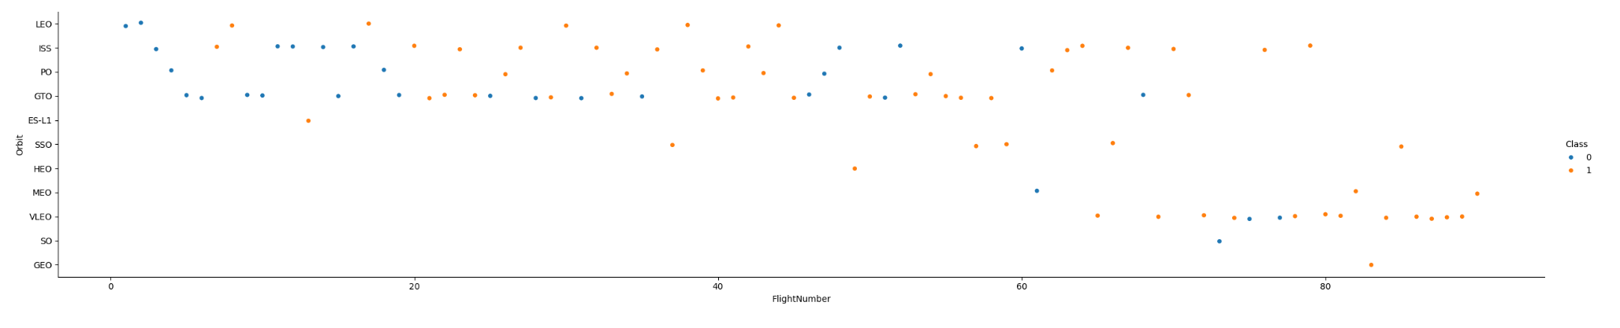
Flight Number vs. Orbit Type
We can see that after some flights the success rate for LEO and VLEO orbits is 100%, for other orbit types there is no visible pattern
Show a scatter point of Flight number vs. Orbit type
Show the screenshot of the scatter plot with explanations

Slide 22
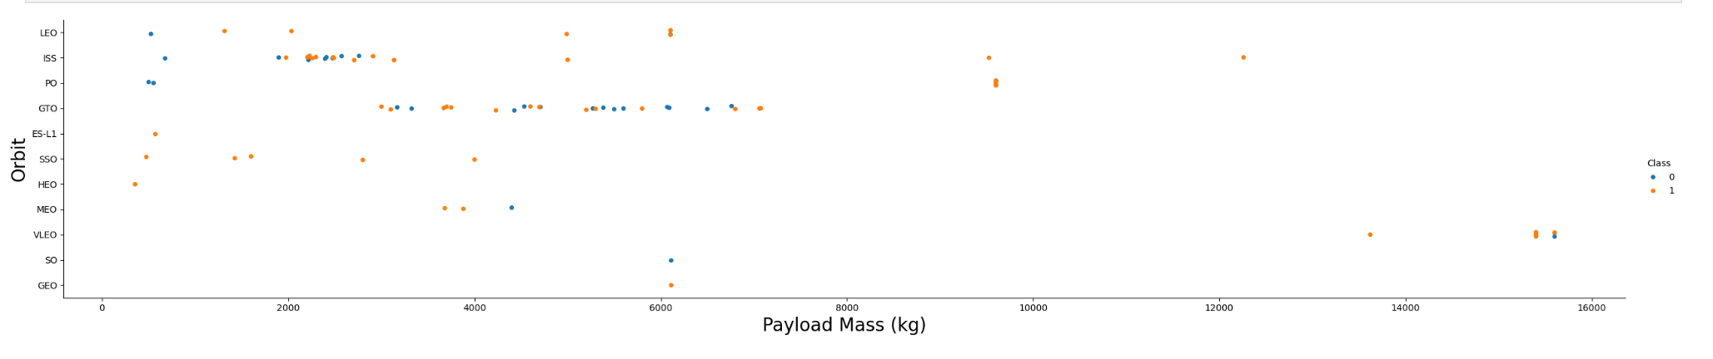
Payload vs. Orbit Type
We can see that for VLEO orbit there is no rocket launched with payload mass under 13000 Kg, additonaly ISS LEO and PO have higher success rate with higher payload mass
Show a scatter point of payload vs. orbit type
Show the screenshot of the scatter plot with explanations

Slide 23
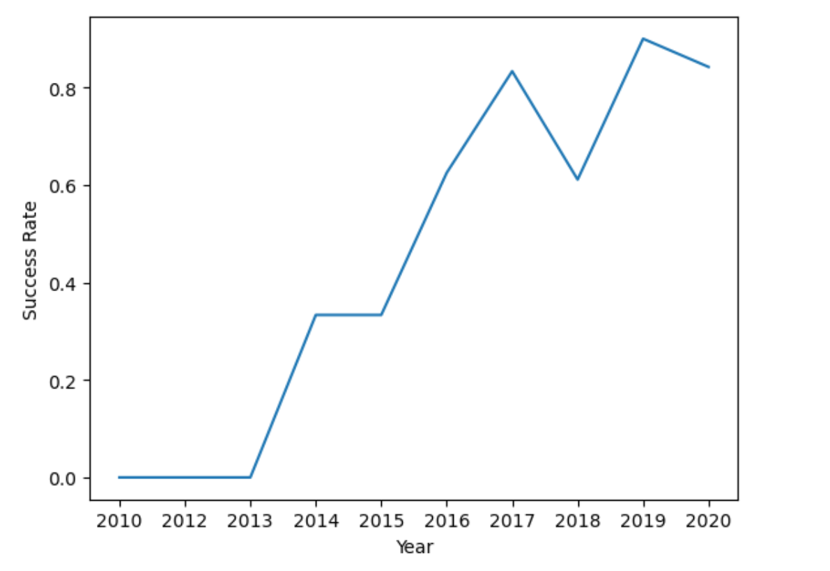
Launch Success Yearly Trend
Show a line chart of yearly average success rate
Show the screenshot of the scatter plot with explanations
With each year the overall success rate rises

Slide 24
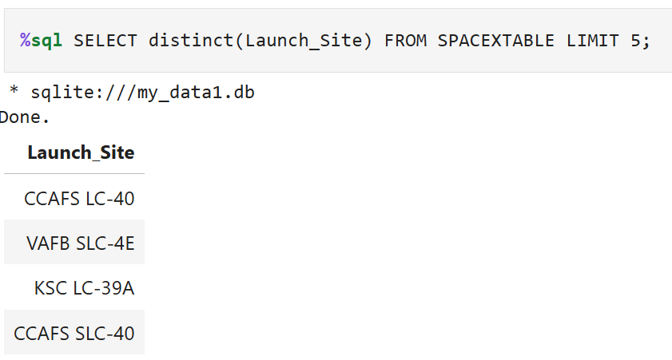
All Launch Site Names
Find the names of the unique launch sites
Present your query result with a short explanation here
Distinct function returns only unique values, limit 5 does nothing because there is only 4 unique values

Slide 25
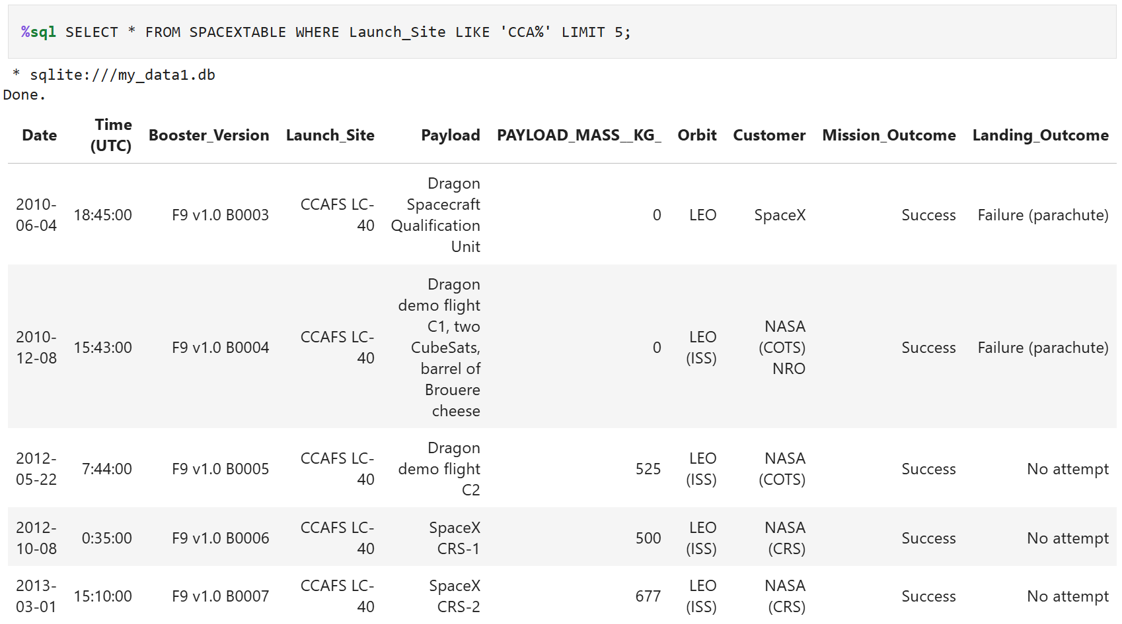
Launch Site Names Begin with 'CCA'
Find 5 records where launch sites begin with `CCA`
Present your query result with a short explanation here
Like function ensure that Launch site matches the pattern CCA% where % means that there might be any characters after CCA

Slide 26
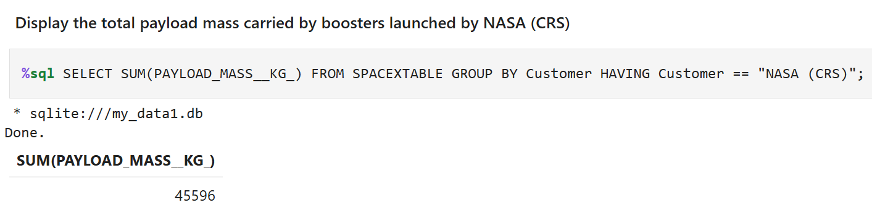
Total Payload Mass
Calculate the total payload carried by boosters from NASA
Present your query result with a short explanation here
I used aggregate function SUM and grouped every customer, using having I only showed booster form NASA (CRS)

Slide 27
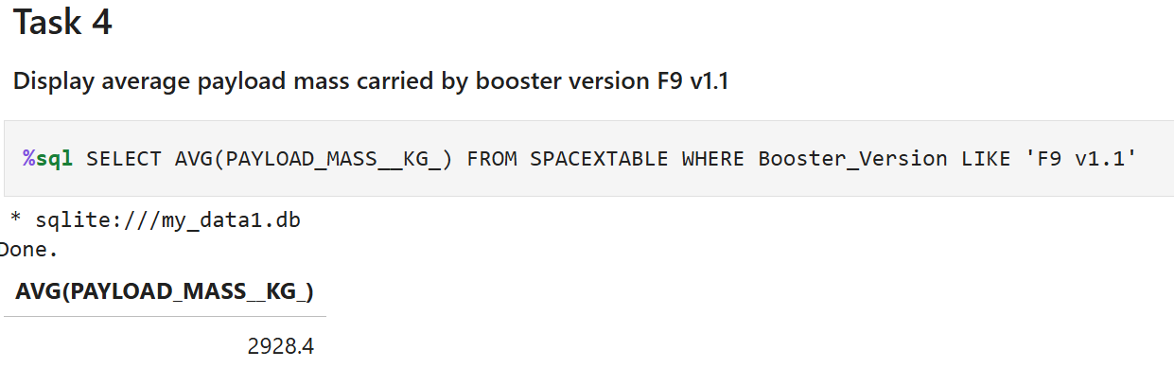
Average Payload Mass by F9 v1.1
Calculate the average payload mass carried by booster version F9 v1.1
Present your query result with a short explanation here
I used aggregate function AVG that calculates mean, only for booster versions that matches F9 v1.1 meaning only F9 v1.1 is taken into consideration

Slide 28
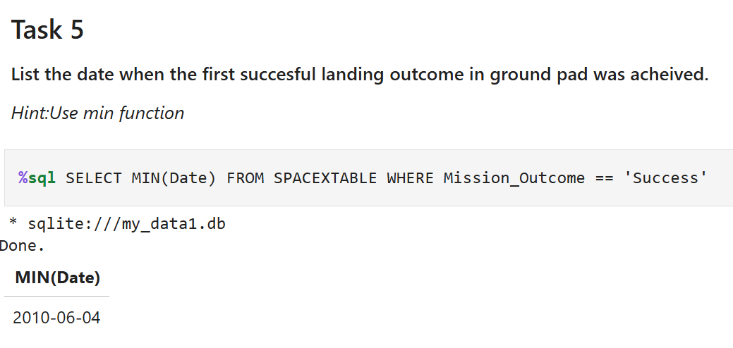
First Successful Ground Landing Date
Find the dates of the first successful landing outcome on ground pad
Present your query result with a short explanation here
I used MIN function that finds me the minimum value, and I filter the set beforehand to take into account only the rows with successful mission outcome

Slide 29
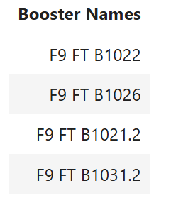
Successful Drone Ship Landing with Payload between 4000 and 6000
List the names of boosters which have successfully landed on drone ship and had payload mass greater than 4000 but less than 6000
Present your query result with a short explanation here
%sql SELECT distinct(Booster_Version) as 'Booster Names' FROM SPACEXTABLE WHERE Landing_Outcome LIKE '%Success%drone%' and PAYLOAD_MASS__KG_ > 4000 and PAYLOAD_MASS__KG_ < 6000
This Like pattern ensures that only values that has Success somewhere and drone somewhere after Success pass

Slide 30
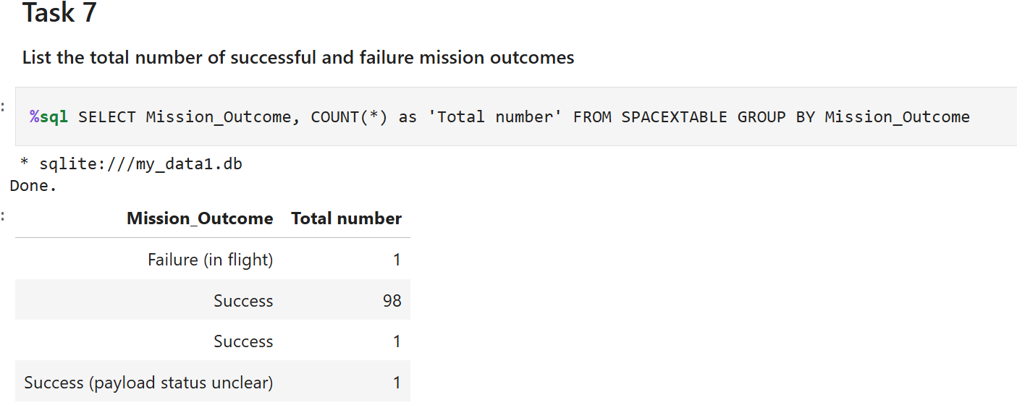
Total Number of Successful and Failure Mission Outcomes
Calculate the total number of successful and failure mission outcomes
Present your query result with a short explanation here
There seems to be an error with the db where one record has probably some additional whitespace characters, I grouped the rows into groupes for each mission outcome and the counted them with COUNT(*)

Slide 31
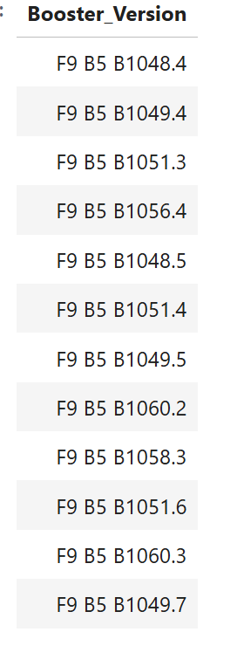
Boosters Carried Maximum Payload
List the names of the booster which have carried the maximum payload mass
Present your query result with a short explanation here
%sql SELECT distinct(Booster_Version) FROM SPACEXTABLE WHERE PAYLOAD_MASS__KG_ == (SELECT MAX(PAYLOAD_MASS__KG_) FROM SPACEXTABLE)
I used subquery here so I can find the maximum value and chose only the booster which have carried maximum payload once or more times

Slide 32
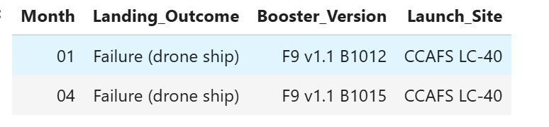
2015 Launch Records
List the failed landing_outcomes in drone ship, their booster versions, and launch site names for in year 2015
Present your query result with a short explanation here
I used substr function to extract year and month from date, Like pattern works as the previous one which I discussed
%sql SELECT substr(Date, 6, 2) as 'Month', Landing_Outcome, Booster_Version, Launch_Site FROM SPACEXTABLE WHERE substr(Date, 0, 5) = '2015' and Landing_Outcome LIKE '%Failure%drone ship%'

Slide 33
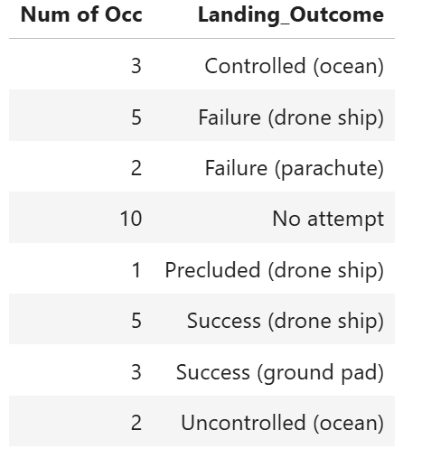
Rank Landing Outcomes Between 2010-06-04 and 2017-03-20
Rank the count of landing outcomes (such as Failure (drone ship) or Success (ground pad)) between the date 2010-06-04 and 2017-03-20, in descending order
Present your query result with a short explanation here
%sql SELECT count(*) as "Num of Occ", Landing_Outcome FROM SPACEXTABLE Where Date Between '2010-06-04' and '2017-03-20' GROUP BY Landing_Outcome ORDER BY DESC
I grouped the outcomes, and then counted them, before grouping I took only the rows between these dates (But I forgot to present here a picture with ordered data, but the query is correct and the results are still very clear despite the lack of sorting)

Slide 34

Section 3

Slide 35
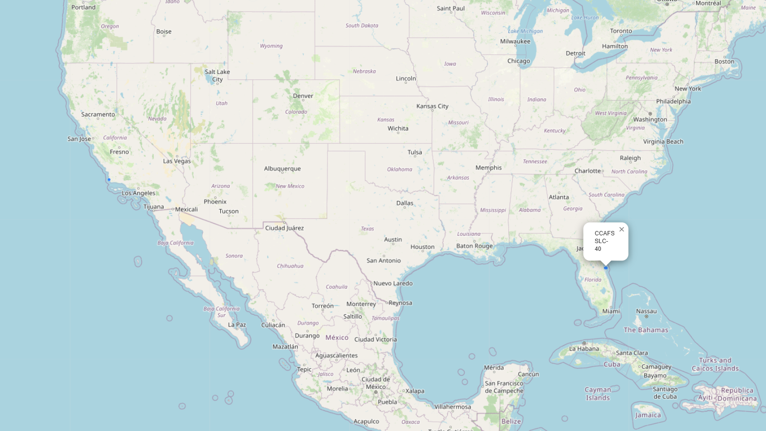
Launch sites
For each site there is a dot representing it, after clicking it a label with the site's name is presented

Slide 36
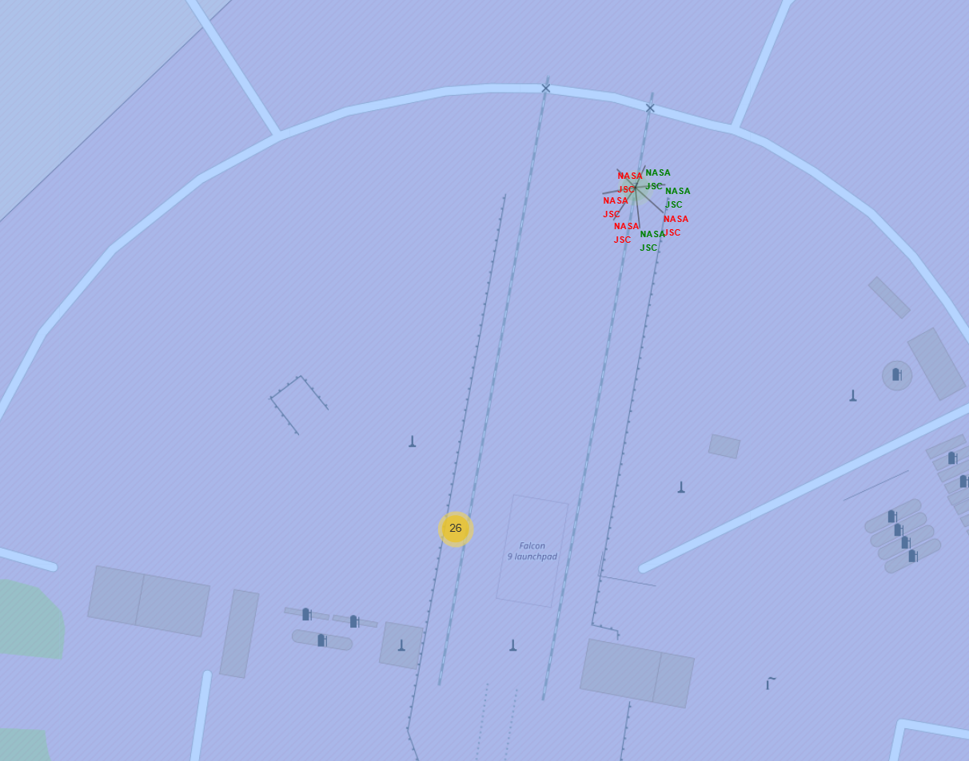
Map of each launch with indication of the outcome
I used markers with combination of marker cluster to show all launches and their outcomes for each site, the green names indicate the success while the red names indicate failure

Slide 37
<Folium Map Screenshot 3>
Replace <Folium map screenshot 3> title with an appropriate title
Explore the generated folium map and show the screenshot of a selected launch site to its proximities such as railway, highway, coastline, with distance calculated and displayed
Explain the important elements and findings on the screenshot

Slide 38

Section 4

Slide 39
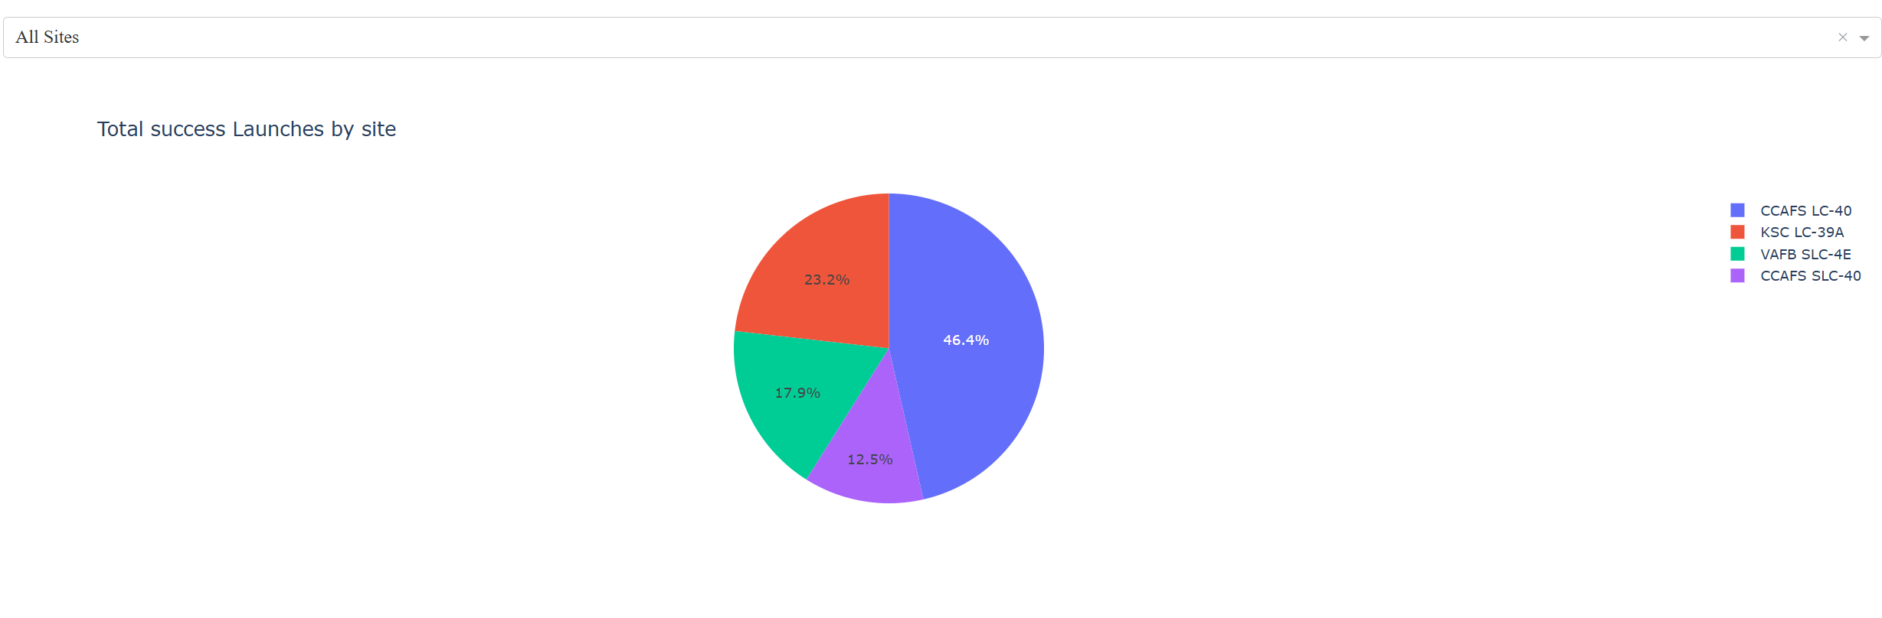
Pie chart of the counted successes for each site
We can see that CCAFS LC had the most successes with launch, after it there was KSC LC, VAFB SLC and lastly CCAFS SLC

Slide 40
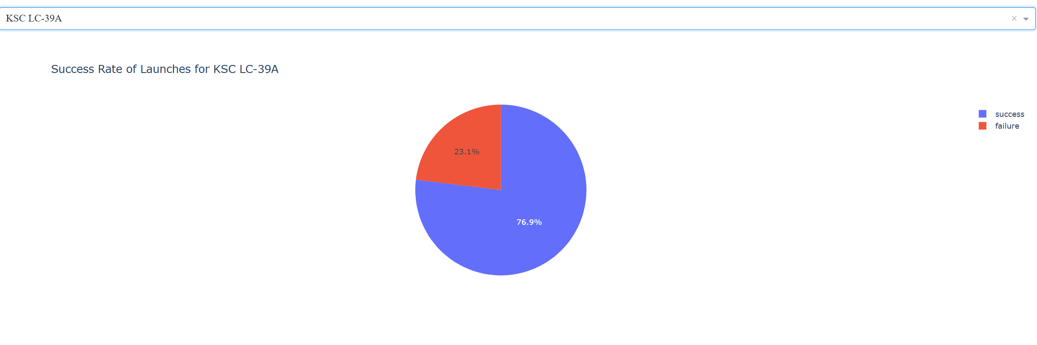
Pie chart for the launch site with the highest successful launch ratio
Replace <Dashboard screenshot 2> title with an appropriate title
Show the screenshot of the piechart for the launch site with highest launch success ratio
Explain the important elements and findings on the screenshot
We can see that despite having fewer overall number of successful launches the KSC LC had the most success with launches

Slide 41
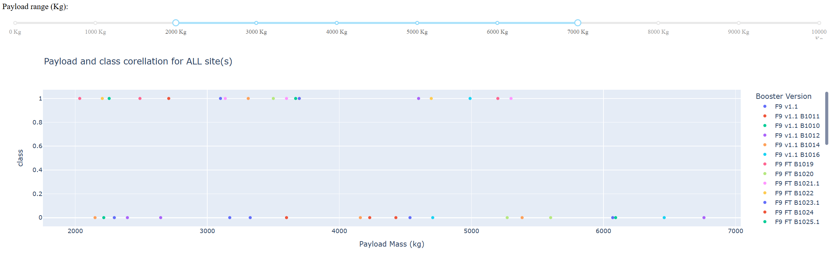
Scatter plot of Payload and class for all sites
There is no clear winner when it comes to booster versions, although F9v1.1 B1011 had the most successful launches, we can see that when payload mass is around 5000 Kg there is high chance of success

Slide 42

Section 5

Slide 43
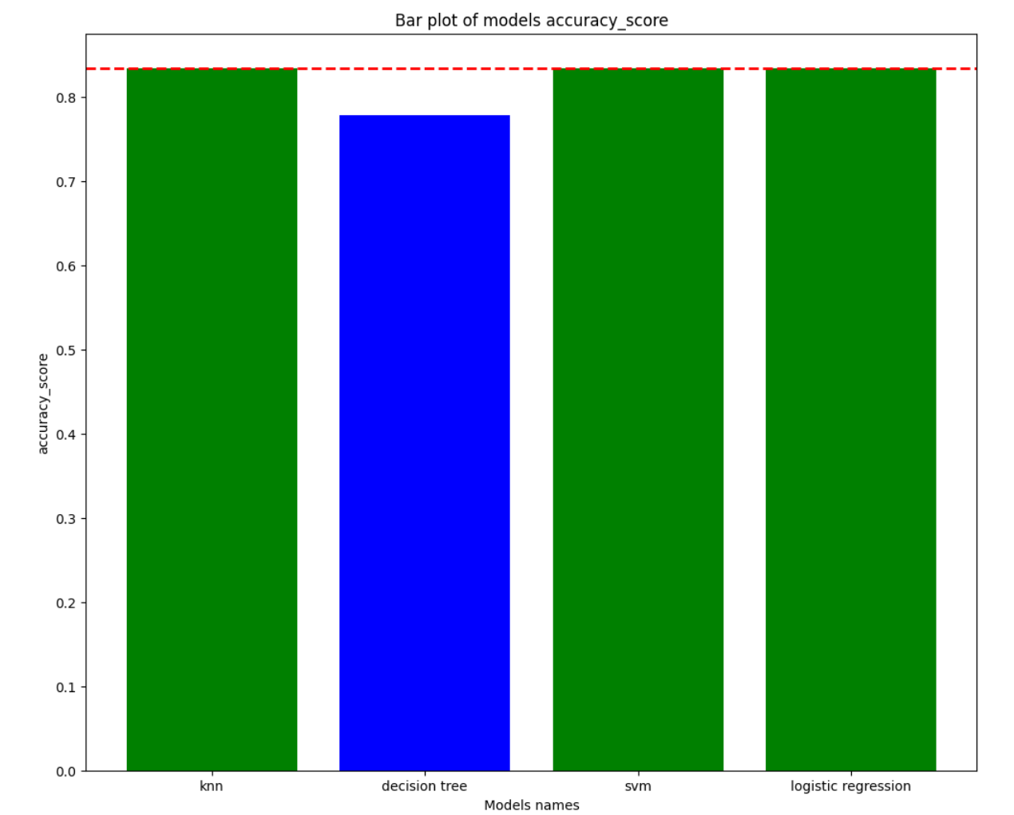
Classification Accuracy
The models that had the highest acc were highlighted wit green color, this means that 3 models had the same or very close accuracy, only lacking was the decision tree

Slide 44
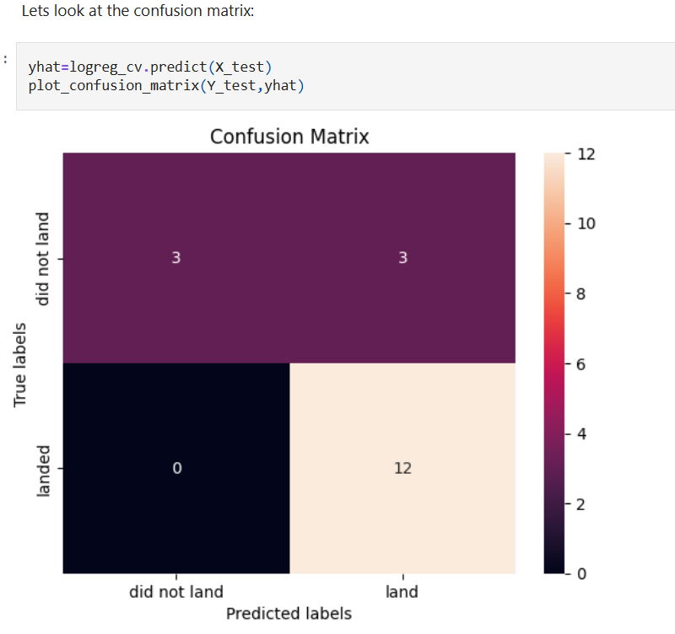
Confusion Matrix
Show the confusion matrix of the best performing model with an explanation
So I decided on the logistic regression model and here is the confusion matrix for it. We can see that there was no false negatives and 3 false positives when we consider land as true positive

Slide 45
Conclusions
We can see that the success rate depends on the type of orbit and the payload mass.
Also there happens to be only one site where the success ratio is more than 50% and its KSC LC.
Every model performed greatly for the predicitions, with decision tree falling slightly behind the competition. This sector is not as important as healthcare for example so the 87% accuracy is satisfactory considering the small dataset.

Slide 46
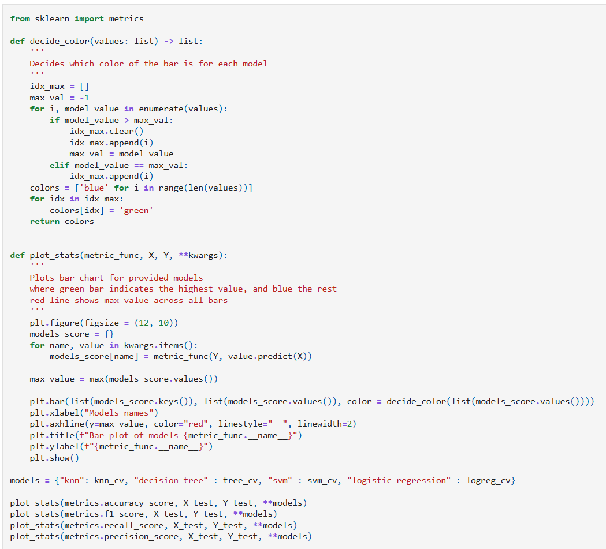
Appendix
Code used for generating barplots for any metric form sklearn metrics (or any self defined one), works for both classification and regression models only if they are not mixed
Github repo with all jupyter notebooks: https://github.com/Gawronek69/IBM_DataScience_Course

Slide 47


